Slide 1
DBMS Users

Slide 2




DBMS Users
Actor on the scene
Classified into mainly
two categories
Workers behind the scene

Slide 3
DATABASE USER
Actor on the scene
Worker behind the scene
Database administrator
Database
designer
Operator and
Maintenance
personal
DBMS system designer
And implementer
End User
Software
Engineer
Tool
Developer
Stand alone users
Casual End Users
Sophisticated users
Naive or Parametric users

Slide 4
Actor on the scene
those who actually use and control the content.
Database Administrator
Database Designer
End user
System analyst and application programmer(software engineer)

Slide 5

1.Database Administrator
  DBA is responsible for authorizing access to the database, for coordinating and monitoring its uses and for acquiring software and hardware resources as needed.
  The DBA can be a single person or a team comprising a group of persons.
The functions of the DBA include the following:
Definition of the Conceptual Schema
Definition of the Internal Schema
Granting of authorization for data access
Defining Integrity constraints

Slide 6
Definition of the Conceptual Schema
To decide exactly what information is to be held in the database.
Identifies the entities and the information to be recorded about those entities. This process is usually referred to as logical database design.
Once the DBA has decided the content of the database at an abstract level, he creates the corresponding conceptual schema

Slide 7
Definition of the Internal Schema
Decide how the data is to be represented in the database. This process is usually referred to as physical database design.
Having done the physical design, the DBA must then create the corresponding storage structure definition.
In addition, the DBA must also define the associated conceptual/internal mapping

Slide 8
Granting of authorization for data access
The granting of different types of authorizations (read, write, etc.) allows the DBA to regulate which parts of the database various users can access
Defining Integrity constraints
The data values stored in the database must satisfy certain consistency constraints

Slide 9
2.Database Designer
Responsible for identifying the data to be stored in the database and for choosing structures to represent and store this data.
These tasks are mostly undertaken before the database is actually implemented and populated with data.
Communicate with the database users to understand the requirements and meet their requirements.

Slide 10
3. End User:
  Deal only with the highest level of abstraction.
  May not be concerned with the details of the DBMS.
  Involved in updates to the database or queries on the database
Categories of end users
Casual End Users
Naive or Parametric users
Sophisticated users
Specialized users

Slide 11

Casual End Users
Access data base occasionally when needed
They need different information each time
example: High level Managers who access the data weekly or biweekly.

Slide 12

II. Naive or parametric users
They make up large section of the database
They communicate with the database on regular period
communicate with the system by invoking one of the applications programs that have been written previously
Their job is to constantly querying and updating database using standard queries
This is called canned transaction
Ex: Bank teller, reservation clerks etc

Slide 13


III. Sophisticated users
They include business analyst , scientist, engineers, other thoroughly familiar with the system capability
They interact with the system without writing programs, instead they form their requests in a database query language

Slide 14
IV. Stand -alone users
Stand-alone : mostly maintain personal databases using ready-to-use packaged applications. An example library management system.

Slide 15

4. S/w Engineers
I. Application programmer
Writing database programs in some programming languages (Such as COBOL,C++ or some forth generation languages)
Application programs access database by issuing the appropriate request to the DBMS.

Slide 16

II. Systems analysts
Architects, as well as the project leaders, of an information system.
It is their job
  Determine the requirements of users (specially naïve and parametric end users)
  Develop solutions to users problems
  Estimate the costs to develop and implement them.

Slide 17





Software Engineers
Application
programmer
System Analyst

Slide 18
Workers behind the scene
those who enable the database to be developed and the DBMS software to be designed and implemented.
Workers behind the Scene
  Typically do not use the database for their own purposes
  DBMS system designers and implementers
  design and implement the DBMS modules (for implementing the catalog, query language, interface processors, data access, concurrency control, recovery, and security. ) and interfaces as a software package

Slide 19
1.DBMS system designers and implementers
  design and implement the DBMS modules (for implementing the query language, interface processors, data access, concurrency control, recovery, and security. ) and interfaces as a software package

Slide 20
2.Tool developers
  Tools are optional packages that are often purchased separately
  system administrator include packages for database design, performance monitoring, natural language or graphical interfaces, prototyping, simulation, and test data generation.
Operators and maintenance personnel
  who are responsible for the actual running and maintenance of the hardware and software environment for the database system.

Slide 21
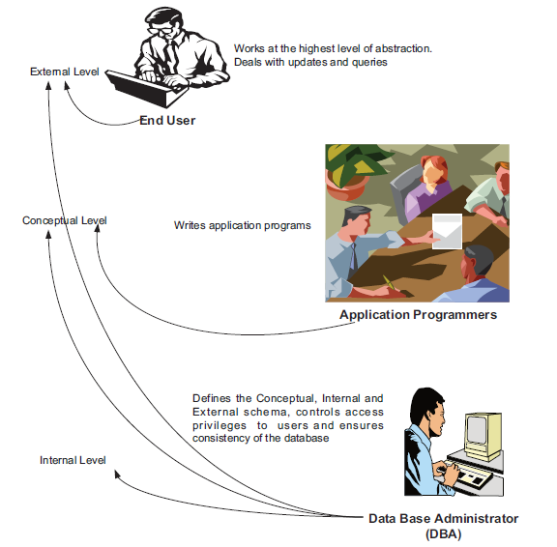

Slide 22
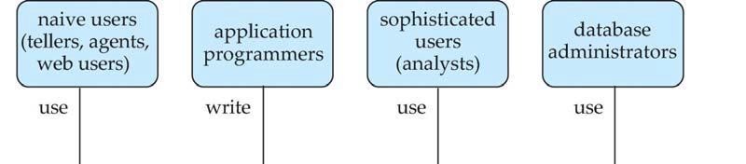
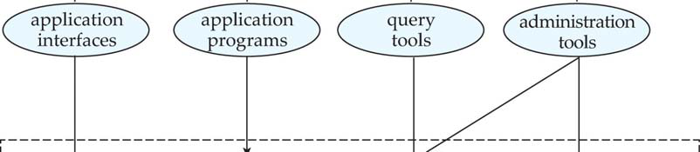
Database Users and Administrators

Slide 23
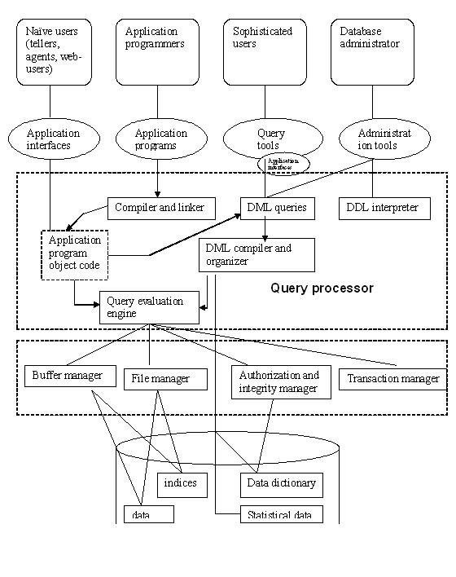
STORAGE MANAGER

Slide 24
Components of Database Engine
Storage manager
Query processing
Transaction manager
Storage Management
Storage manager is a program module that provides the interface between the low-level data stored in the database and the application programs and queries submitted to the system.
The storage manager is responsible to the following tasks:
Interaction with the OS file manager
Efficient storing, retrieving and updating of data
Issues:
Storage access
File organization
Indexing and hashing

Slide 25
Query Processing
Alternative ways of evaluating a given query
▪ Equivalent expressions
▪ Different algorithms for each operation
▪ Cost difference between a good and a bad way of evaluating a
query can be enormous
▪ Need to estimate the cost of operations
▪ Depends critically on statistical information about relations
which the database must maintain
▪ Need to estimate statistics for intermediate results to compute
cost of complex expressions

